Slide 1
Mambo Number 5
Kristin, Ted & Virginia

Slide 2
Topic
Investigate if there exists a trend in data on happiness, Gross Domestic Product and Consumer Price Index of countries around the world.
The data we are going to look at is from 2015 and 2016.
We want to find out if there is a relationship between happiness and gross domestic product and also, happiness and consumer prices index

Slide 3
Data sources
Kaggle: Happiness
World bank: Population, gross domestic product and consumer price index
We used pandas to clean and process the data we downloaded from the two sources.

Slide 4
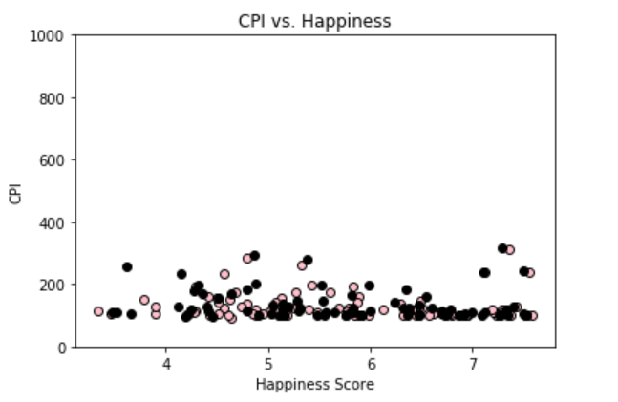
Consumer Price Index vs. Happiness Score

Slide 5
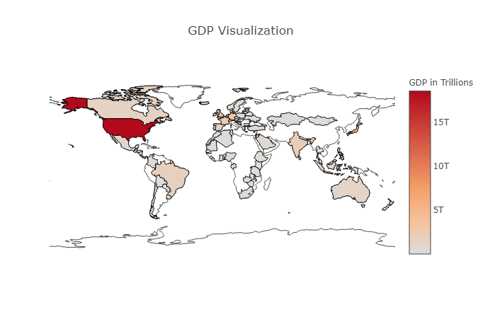

Slide 6
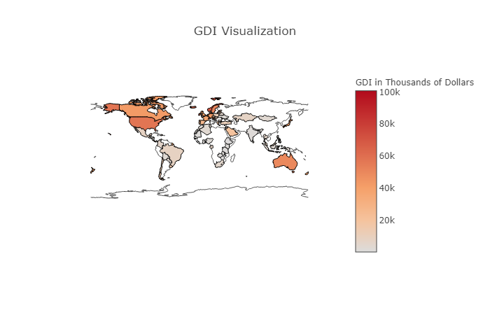

Slide 7
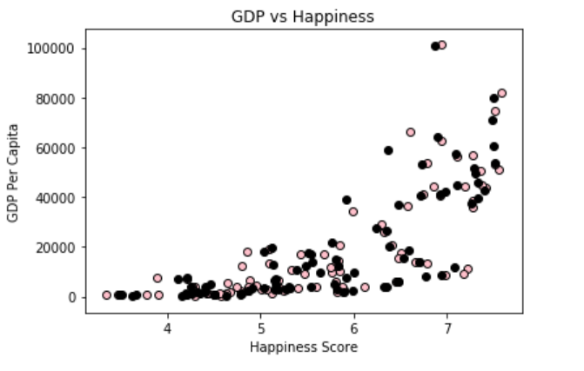
GDP Per Capita vs Happiness

Slide 8
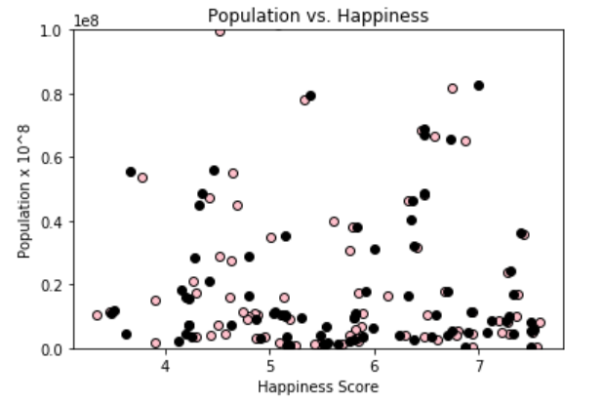
Population vs. Happiness

Slide 9
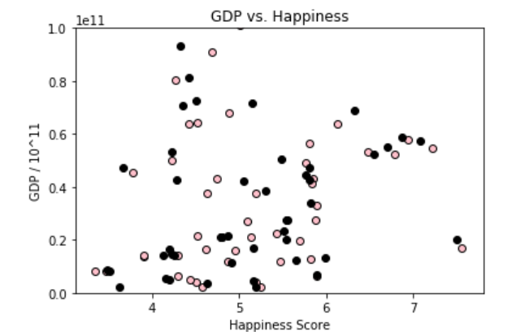
Gross Domestic Product vs. Happiness

Slide 10
CONCLUSION
Does population, GDP or CPI affect happiness more? The answer is GDP per capita has a stronger correlation with the average happiness for a country.

